Slide 1

The 2025 Oracle Health Data Breach
A Case Study in Cloud Security Risks
Presented by: Akm Nizum
Date: 05/06/2025

Slide 2

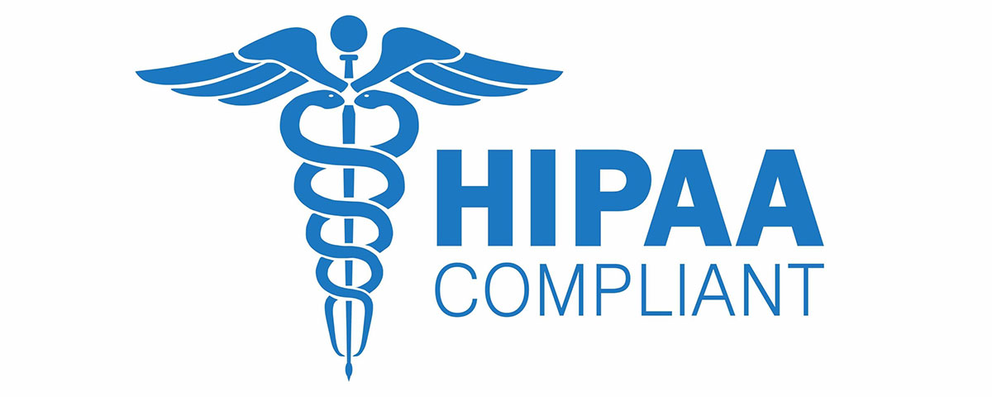
What is Oracle and HIPAA?
Oracle is a multinational computer technology corporation that primarily develops and markets database software, cloud-engineered systems, and enterprise software products.
HIPAA stands for the Health Insurance Portability and Accountability Act, a federal law enacted in 1996 that aims to protect patient privacy and ensure the security of health information.

Slide 3
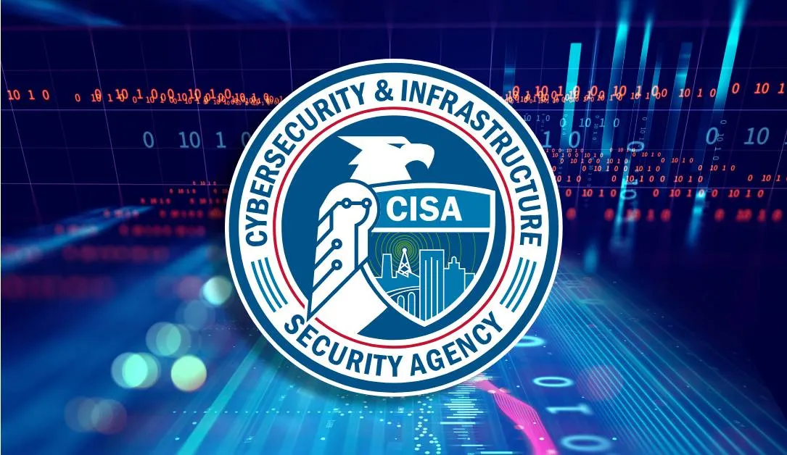
Justification
Major breach affecting sensitive healthcare data.
Highlights risks in third-party cloud services.
Led to regulatory scrutiny and CISA (Cybersecurity and Infrastructure Security Agency) advisories.
Demonstrates the impact of credential-based attacks.

Slide 4

So…What happened?
Oracle recently experienced two separate data breach incidents. The first occurred around February 20, 2025, when Oracle Health discovered a security breach within its network. They initiated an investigation and found that on or after January 22, 2025, an unauthorized third party had accessed the company's servers and copied patient data to an unknown external location.
The second incident involved Oracle Cloud servers. In this case, a hacker using the online alias rose87168 posted on a cybercrime forum, offering the data of 6 million Oracle Cloud customers. Although Oracle has denied this data breach.

Slide 5

Background & Overview
What Happened?
Why It Matters
Oracle Health, formerly cerner suffered a breach exposing patient records.
Healthcare data is highly sensitive (HIPAA).
Attackers exploited weak credentials.
Raises concerns about cloud service provider security.
Linked to a broader Oracle Cloud vulnerability.

Slide 6

Hacking Timeline:
1
January 22
Stolen credentials were used to access the legacy servers.
2
February 20
The security incident was identified.
Threat Actor:
1. ANDREW
2. ROSE87168

Slide 7

Key Dates:
January 2025
January-February 2025
Late February 2025
Initial system infiltration
Attackers maintained persistent access for approximately two months
Initial detection of suspicious activity
Early March 2025
Oracle initiated an internal investigation after receiving a ransom demand
March 20, 2025
Stolen data appeared for sale on BreachForums by a threat actor using the handle "rose87168"

Slide 8

Technical Analysis (Attack Methodology)
Attack Vector
Vulnerabilities Exploited
Credential stuffing / weak password exploitation.
Insufficient MFA enforcement.
Impact
Exposure of PHI (Protected Health Information).

Slide 9
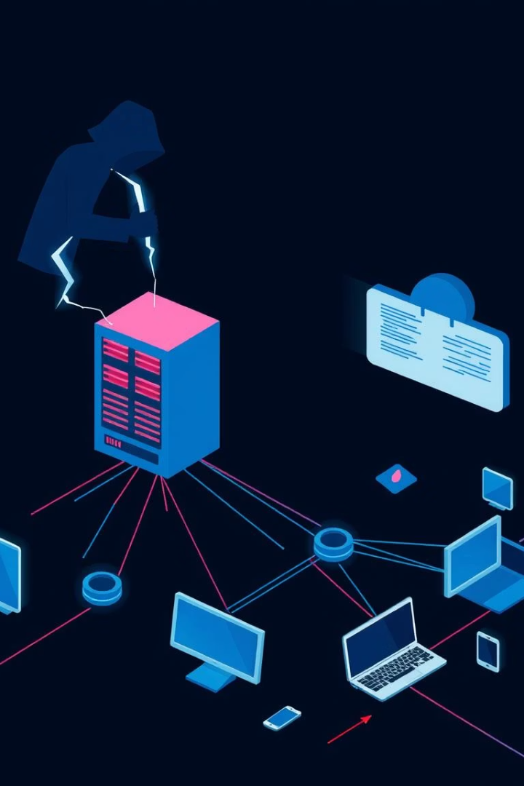




Technical Diagram of the Breach
Entry
Stolen/weak credentials.
Lateral Movement
Within Oracle’s cloud.
Access
Healthcare databases.
Exfiltration
Sensitive patient data.

Slide 10
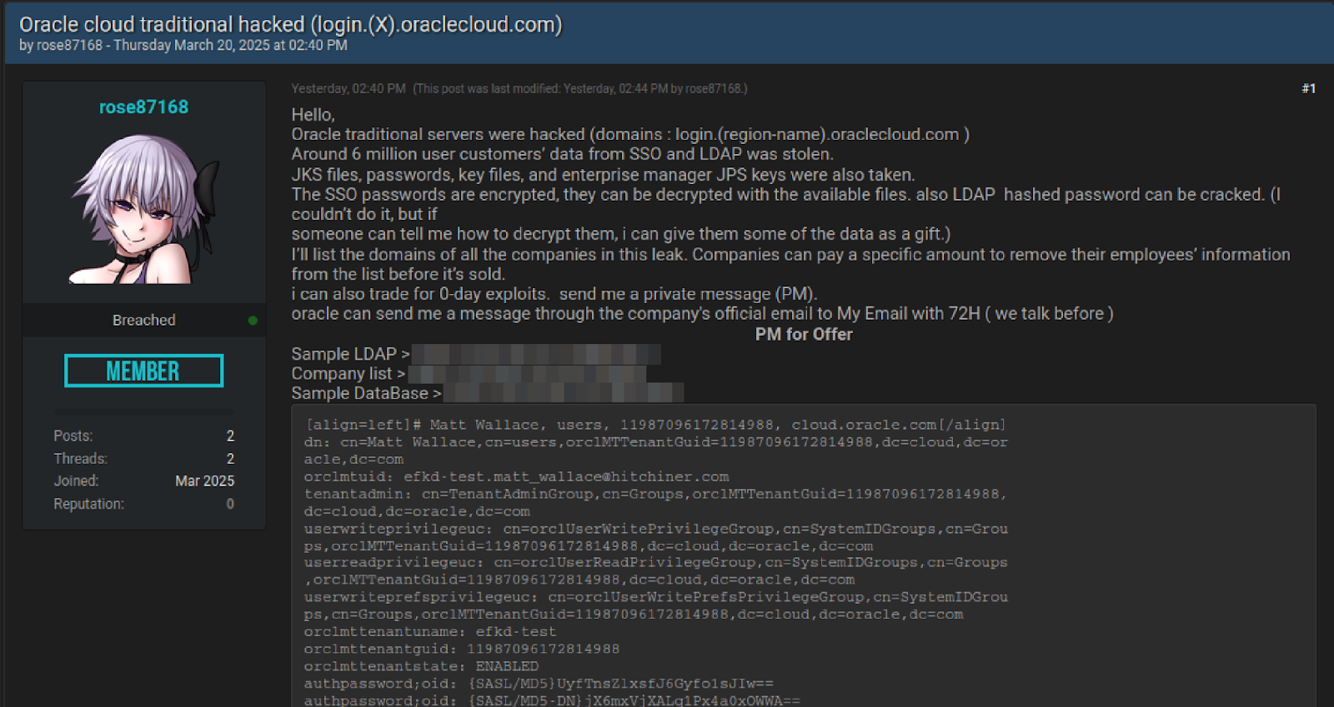

Slide 11
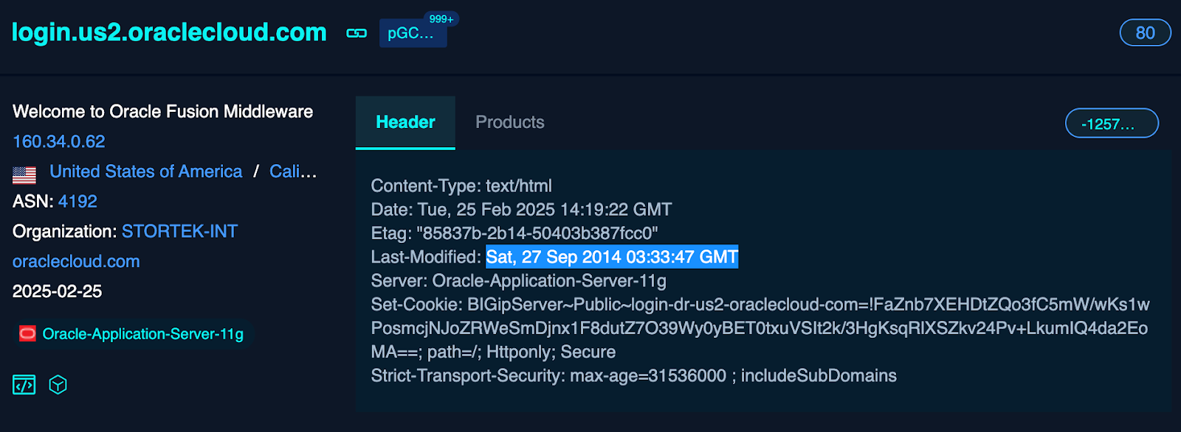
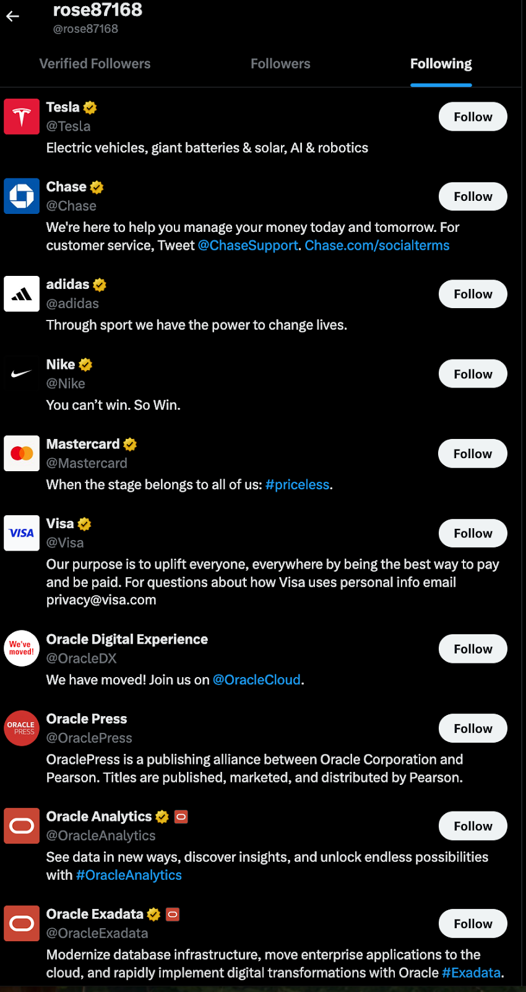
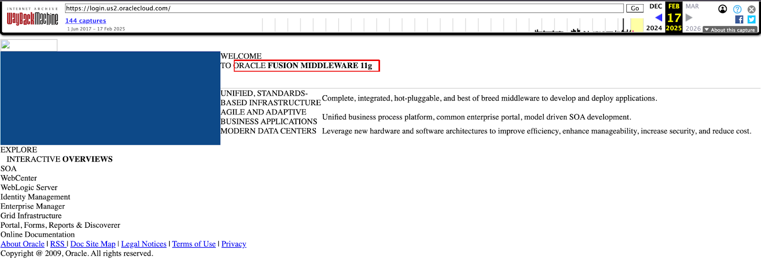

Slide 12

Technical Vulnerabilities Exploited:
The Oracle fusion middleware had a critical vulnerability CVE-2021-35587 which affects Oracle Access Manager (OpenSSO Agent) Which was added to CISA KEV(Known Exploited Vulnerabilities) on 2022 December.
The exploited Java vulnerability allowed unauthenticated attackers network access via HTTP
This access led to complete compromise of Oracle Access Manager
Poor patch management and outdated configurations on legacy systems
Inadequate monitoring of authentication infrastructure
Insufficient isolation between legacy and modern cloud systems

Slide 13
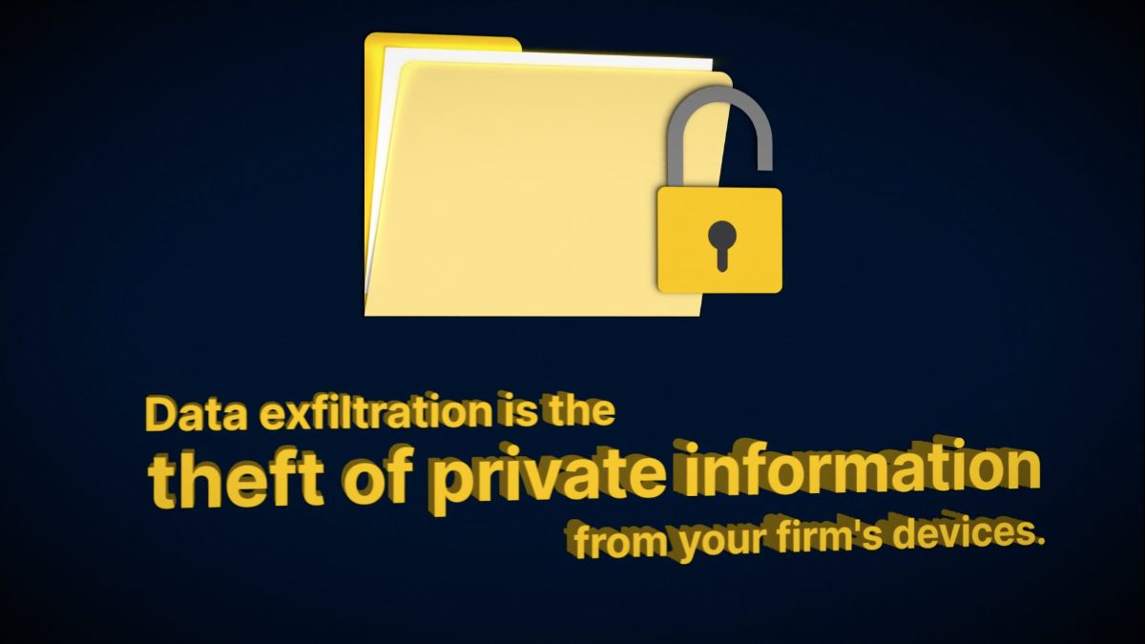
Data Exfiltration and Impact:
The scale of the breach was substantial:
Approximately 6 million records were stolen
The compromised data included:
Usernames, email addresses, and hashed passwords
Encrypted SSO and LDAP credentials
Java Key Store (JKS) files
Enterprise Manager JPS keys
Over 140,000 Oracle cloud tenants were potentially affected
The stolen data dated back at least 16 months

Slide 14

Organizational Impact
HIPAA compliance concerns.
Patient trust erosion.
Regulatory Response
CISA warned organizations.
Potential fines under HIPAA.

Slide 15

Countermeasures Deployed
Enhanced cloud monitoring.
Forced password reset
Acknowledged the breach to affected customers (though notably not via public disclosure initially)
Engaged CrowdStrike for forensic investigation
Cooperated with FBI investigations
Implemented security enhancements for legacy systems
Reassured stakeholders that the primary Gen 2 cloud infrastructure remained secure.
Oracle’s Response

Slide 16




Lessons Learned
Third-party risk
Management is critical.
Credential hygiene
Prevents breaches.
Cloud security
Monitoring is essential.
Future Mitigations: Zero Trust Architecture adoption. Regular penetration testing of cloud environments.

Slide 17

Conclusion & References
Summary:
The Oracle breach underscores cloud security risks.
Proactive measures (MFA, audits) can prevent future incidents.

Slide 18

Alder, S. (2025, March 31). Oracle Health Breach Affects Patients of Multiple
U.S. Hospitals. The HIPAA Journal. Oracle Blogs+9Oracle+9Oracle Docs+9
CloudSEK. (2025, March 27). The Biggest Supply Chain Hack of 2025:
6M Records Exfiltrated from Oracle Cloud Affecting Over 140K Tenants.
CloudSEK Blog. Oracle+4Oracle+4Oracle+4
Bloomberg Law. (2025, April 2). Oracle Health Hit With Class
Action Over Breach of Patient Data. Bloomberg Law.
Huang, K. (2025, April 18). Oracle Cloud Infrastructure Breach:
Mitigating Future Attacks with Agentic AI. Cloud Security Alliance Blog. Oracle
Jones, C. (2025, April 2). How Oracle Took a Security Breach Claim and
Made It Worse. The Register. Oracle Docs
Oracle. (n.d.). Security Incident Response. Oracle. ​

